Slide 1

LitCiter Basics
Health and Environmental Research Online
Office of Research and Development
National Center for Environmental Assessment
08/29/2013

Slide 2
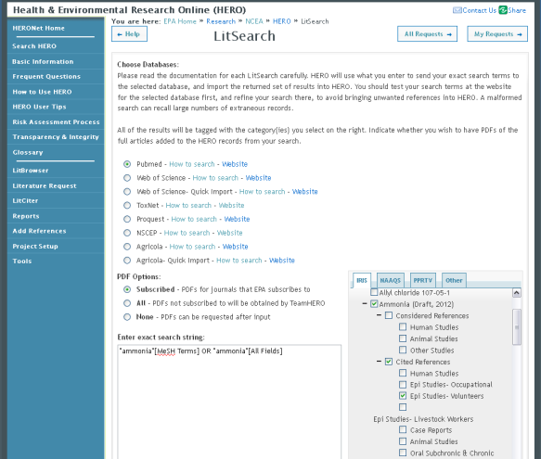
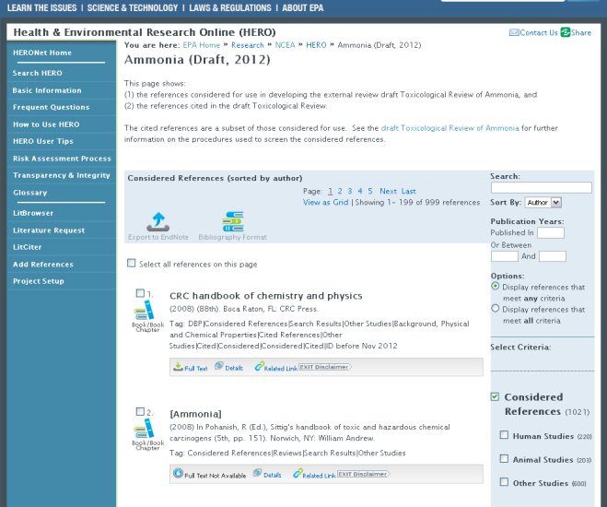
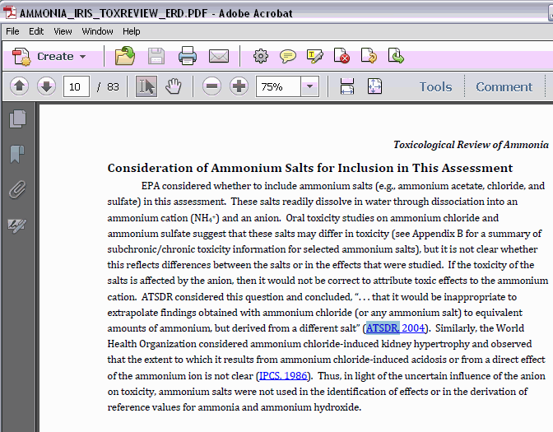
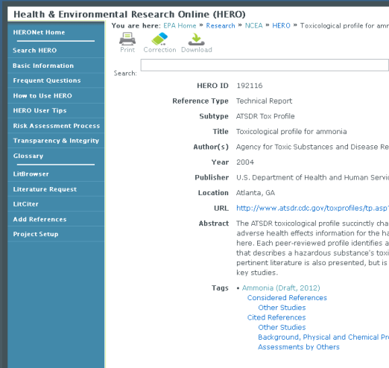
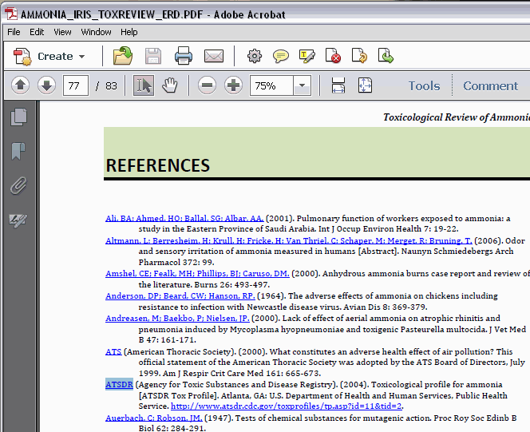
LitSearch
Project Page
Import and
Systematic Review
Link to Details and Full Text
Draft and Final Assessments
Reference Details
LitCiter
CWYW
Link to Details and Full Text

Slide 3
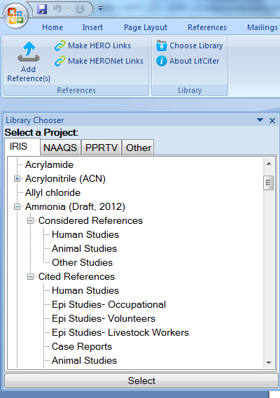
LitCiter
Relationship with other citation software and databases--EndNote, Microsoft Word—allows for effortless cite while you write (CWYW) and mass tagging.
  Consistent with NCEA and EPA standards
  Creates a reference list from in text citations
Linked Citations: references within new EPA assessments are linked to the HERO database
  Hyperlink works for public HERO and extranet HERONET

Slide 4
Find it, Install it, Configure it
Find it
  https://hero.epa.gov/litciter

Slide 5
Find it, Install it, Configure it
Install it (EZTEch)
  Minimum Requirements
    Windows XP or Windows 7
    EndNote X4, X5, and X6(If older versions are installed in parallel, remove all versions older than X4 and repair most recent version.)
    Microsoft .Net Framework 3.5 SP1
    MS Office 2007
  Install Instructions
    Download LitCiter 2.5.11 to the desktop and unzip.
    User must be logged on as administrator. Run Add/Remove Programs from the Control Panel. Check for previous versions of EndNote (older than X4). Uninstall all older versions. Then click Change > Repair to repair the MS Word add-in.
    Install LitCiter by clicking Setup.exe.
    Double click "setup.exe" in the LitCiter folder. Confirm prompts to install components.

Slide 6
Find it, Install it, Configure it
Configure it
  Configure EndNote Preferences
  These settings will apply to all documents
    Start EndNote.
    In the menu bar, go to Edit > Preferences
    Click "Reference Types," then "Import..." Locate HERO.xml in the LitCiter folder and click "Open" and "OK.“
    Click "Temporary Citations," then check box "Use field instead of Record Number" and choose "Label." Click OK
    Click "Libraries." Click on the pull-down arrow next to "When EndNote Starts" and select "Do nothing.”
    Click "Folder Locations," then make note of the path for the Style Folder, or choose a new folder by clicking "Select Folder.”
    Go to the LitCiter folder and copy HERO.ens into the Styles Folder
    Click "OK" to dismiss the Preferences window and save changes.

Slide 7
Find it, Install it, Configure it
Configure it
  Configure Bibliography Preferences
  These settings are saved with each document.
    In Word, click the EndNote tab
    Click the arrow next to Bibliography.
    In the Format Bibliography window, set output style to "HERO" and check boxes for "Link in-text citations to references in the bibliography" and "Underline linked in-text citations."

Slide 8
A few “How-to” Tips*
Turn off Track Changes when formatting.
Use “View” = ‘Draft View, when asking your computer to use Working Memory (RAM).
When editing content (with Track Changes), have your name appear with the changes (Review Tab choices).
Choose under Review Tab: Balloons: All revisions “in line” (to keep the margins wide when comments are still in the document). Can switch back anytime to see “Comments” more easily.
Do not use carriage returns, tabs, and other blank characters to create white space in a document.
* From Creating Section 508 Compliant Documents

Slide 9
Other Settings*
Field Shading: Always on.
Home, Paragraph Mark (show hidden marks): On
Turn off “Auto-correct” functions. (Word Options, Proofing, Auto correct option: uncheck all).
* From Creating Section 508 Compliant Documents

Slide 10
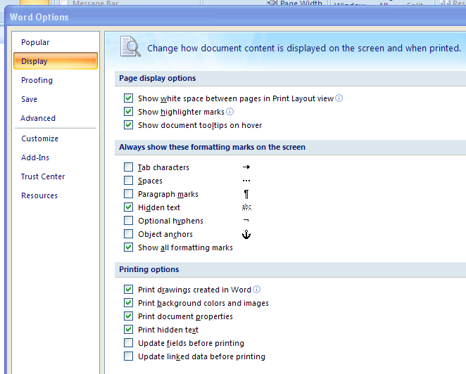
Word Options: Display Settings*
* From Creating Section 508 Compliant Documents

Slide 11
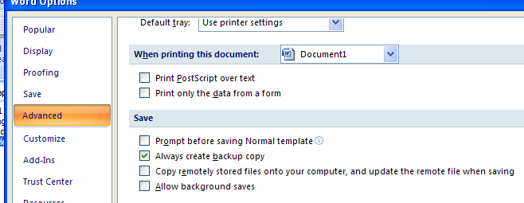
Word Options: Advanced: Save*
* From Creating Section 508 Compliant Documents

Slide 12
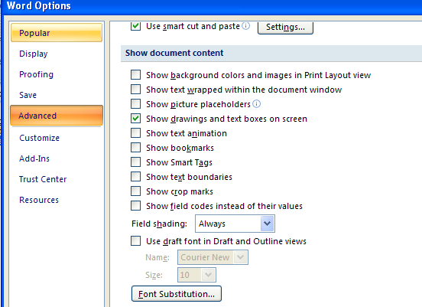
Word Options: Advanced: Show Document Content: Field Shading*
* From Creating Section 508 Compliant Documents

Slide 13
HERO/ Endnote Links in Headings, Headers, Footers, Captions*
Keep the Links until after the final Endnote update and HERO Links application, in Headers, Table Captions, and Figure Captions & Captions.
Unlink (Ctl-Shift F9) the links (keep the text) in the ones that will populate the TOC.
Be sure the Link is repeated in the text near the Figure, in the figure note, or in the Table footnote, before you unlink it in the caption or heading.
Use Ctl-C to copy, then Paste button arrow (Paste Special: RTF [rich text format]) to copy the link. Be sure to select All of the EndNote / HERO Link to copy properly.
* From Creating Section 508 Compliant Documents

Slide 14
EndNote / HERO / HERONet Links*
Troubleshoot while Unformatted:
Keep unformatted. Only update the citations and bibliography in copies (not the primary electronic document) to check for EndNote problems.
While the citations are Unformatted (Find = Ctl-F):
  Find: # symbol = traveling library
    Replace #number with HERO number
  Find: “4 any digit)” = unlinked ref … 2006)
  Find: “4 any digit & 1 any letter” = unlinked ref: 2006a
* From Creating Section 508 Compliant Documents

Slide 15
Add missing Refs to EndNote*
Add the missing HERO numbers to the EndNote Library. (“Add a Reference” button in LitCiter (while you have the just downloaded EndNote Library .enl open).
Update again EndNote again.
Trouble shoot other problem citations.
Use the EndNote Library to check for misspelled Authors, etc.
* From Creating Section 508 Compliant Documents

Slide 16
Request Corrections in HERO*
If you find a misspelled Author, wrong year, etc in HERO, request a correction for that HERO number.
Wait until you hear back from TeamHERO that your correction has been completed.
Re-download the EndNote Library.
Reformat in EndNote
* From Creating Section 508 Compliant Documents

Slide 17
Apply Final HERO Links (Public) and/or HERONet Links*
Apply HERO Links (Public) or HERONet Links to the Word Document (while .enl is still open), using the LitCiter Word Add-In.
Replace 2 spaces with 1 space.
Format the Biblio (No line numbers, 6 pt before and after, hanging by 0.2 inches, indent 0.5 inches), ISAs: Times New Roman 10.
IRIS: Cambrian 10.
If your document needs a version with public HERO links (for the public to review), use HERO links. If you document also needs HERONet links for your peer reviewers, use HERONet links.
HERO links can be converted to HERONet Links, and visa versa, without your EndNote library .enl being open.
* From Creating Section 508 Compliant Documents

Slide 18
Individual Chapter Biblio Lists*
HERO Sections (EndNote Style) instead of HERO.ens (EndNote Style).
Add a Biblio just before each Section Break instead of just at the end of the document.
Be careful if you have other-than end of Chapter Section Breaks already.
* From Creating Section 508 Compliant Documents

Slide 19
Options for Chapter Biblios*
Temporarily remove other-than end of chapter section breaks; update endnote. Apply hero links (litciter).
Or – use HERO.ens to update all the citations, then make a copy (that will not be used for anything else) … remove all the other-than end of chapter section breaks, then use HEROSections.ens on that copy; Apply hero links (litciter); copy and paste the individual chapter lists into the primary electronic document.
If Option 2 is chosen, be careful pasting the lists in, to be sure the links are not broken.
Note: changing from HERO to HERONet <=> no need to have .enl library open. Just changing from http to https.
* From Creating Section 508 Compliant Documents

Slide 20
Small Spot Fixes in already updated document, within 2 days of posting (EndNote and HERO)*
Open the .enl EndNote Library.
Create a “new” Word file.
Open the Biblio tool in EndNote Tab in New Word File.
Click the blue underline box.
Copy the citation from the report that you want to change from a (Author, Year) format and paste into New Document.
Convert to Unformated citation; edit {Smith, 2010, 45782} to Smith et al. {,2010, 45782} - - or {Smith, 2010, 45785@@author-year}
Update, apply HERO Links (LitCiter), Copy and Paste back.
  Be careful – if you need an a or b or c added – copy the other Smith 2010 refs used in the report, and paste into the New document too.
  They should update with the same order of a/b/c/d/etc. as the primary document.
* From Creating Section 508 Compliant Documents

